Slide 1

DIVISION OF ARTIFICIAL INTELLIGENCE AND MACHINE LEARNING
SCHOOL OF COMPUTER SCIENCE AND TECHNOLOGY
MP2911 MINI PROJECT
EVEN SEMESTER 2025-2026
FINAL REVIEW- 18/04/2026
“Computer Vision Based Ambulance Detection and Emergency SMS Alert System”
SUPERVISED BY
Mrs . ANGELIN JEBA P
(ASSISTANT PROFESSOR)
PRESENTED BY
MERSHICK J (URK23CS5056)

Slide 2

AGENDA
ABSTRACT
OBJECTIVE
INTRODUCTION
PROBLEM STATEMENT
LITERATURE SURVEY
PROPOSED METHODOLOGY
MODULES DESCRIPTION
IMPLEMENTATION
RESULTS AND DISCUSSION
CONCLUSION
OUTPUT-SCREENSHOTS
REFERENCES

Slide 3
ABSTRACT
This project presents a real-time Computer Vision-based Ambulance Detection System integrated with an automated SMS alert mechanism using the Twilio API. The system utilizes a Deep Learning model (YOLO) trained on a custom dataset to accurately detect ambulances in traffic video streams. Video frames are processed using OpenCV, and the trained model identifies the presence of an ambulance with high confidence.
Upon detection, the system automatically triggers an alert and sends an SMS notification to a registered mobile number, enabling faster response and improved coordination in emergency situations. This approach reduces dependency on manual monitoring and enhances the efficiency of emergency traffic management. The proposed system demonstrates the practical application of artificial intelligence, computer vision, and cloud-based communication services in real-world scenarios, and can be further extended for smart city infrastructure and intelligent traffic control systems.

Slide 4
OBJECTIVES
Aim of the Project: The aim of this project is to develop a real-time Computer Vision-based system that can accurately detect ambulances in traffic using a Deep Learning (YOLO) model and automatically send SMS alerts through the Twilio API. The system is designed to reduce emergency response time by enabling quick identification of ambulances and immediate communication to concerned authorities, thereby improving traffic management and public safety.
Scope of the Project : The project focuses on real-time ambulance detection using deep learning and automated SMS alerts, with future scope for smart traffic signal integration and smart city deployment.

Slide 5
INTRODUCTION
With the rapid growth of urbanization, traffic congestion has become a major challenge, especially affecting emergency services such as ambulances. Delays in ambulance movement can lead to critical consequences, including increased risk to patient lives. Traditional traffic monitoring systems mainly rely on manual observation through CCTV cameras, which is inefficient and lacks the ability to automatically identify emergency vehicles in real time.
To address this issue, this project proposes a Computer Vision-based Ambulance Detection System using Deep Learning techniques. The system utilizes the YOLO (You Only Look Once) model to detect ambulances from live or recorded video streams with high accuracy. Once an ambulance is detected, the system automatically triggers an alert and sends an SMS notification using the Twilio API. This enables faster communication with authorities and helps in improving emergency response time.

Slide 6
PROBLEM STATEMENT
In rapidly growing urban areas, traffic congestion has become a major challenge, significantly affecting emergency response systems. Ambulances transporting critical patients often experience delays due to heavy traffic and lack of priority management. Current traffic monitoring systems primarily rely on manual CCTV observation, which does not provide automatic identification of emergency vehicles. The absence of intelligent detection and alert mechanisms results in delayed coordination between traffic authorities and emergency services.
Traditional traffic systems lack automated emergency vehicle recognition and notification mechanisms.
Delays in ambulance movement can increase risk to patients, making intelligent detection systems essential.
Delays in ambulance movement can increase risk to patients, making intelligent detection systems essential.

Slide 7
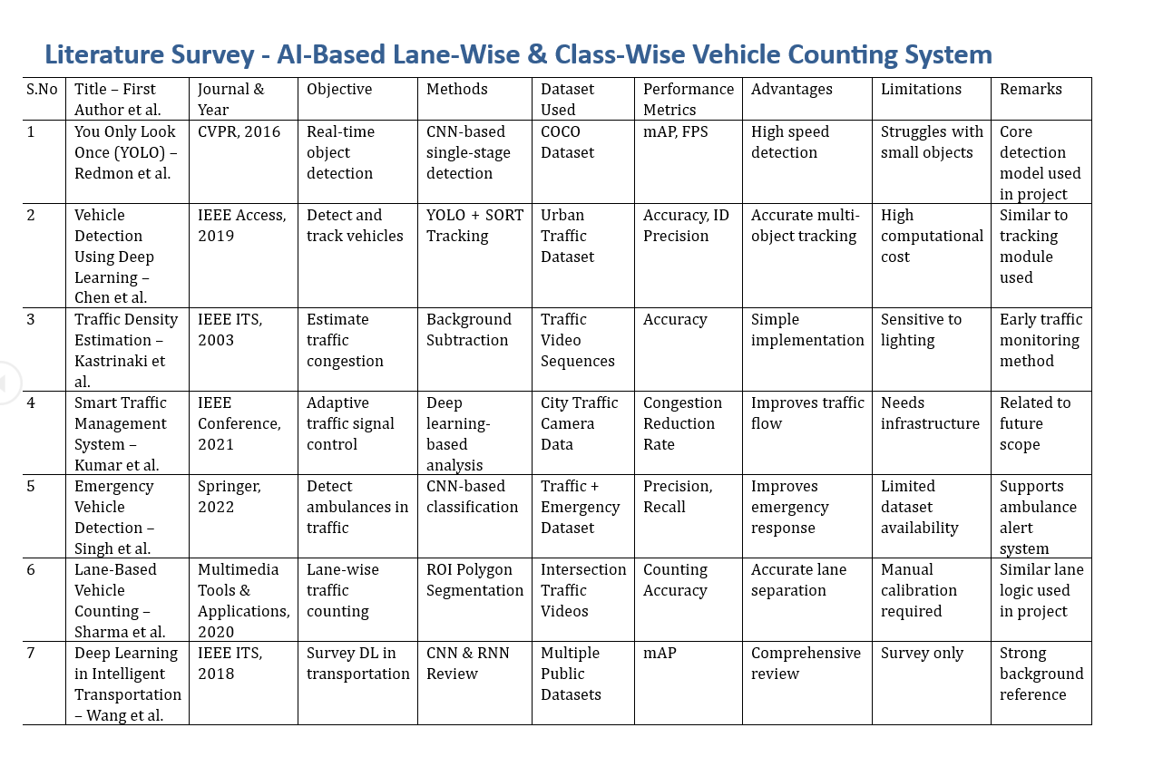
LITERATURE SURVEY

Slide 8
PROPOSED METHODOLGY
The system captures video, detects ambulances using a YOLO model, and sends SMS alerts via Twilio when an ambulance is identified.
Video Input
YOLO Detection
Ambulance Identified
Twilio SMS Alert

Slide 9
MODULES DESCRIPTION
The proposed system is divided into the following functional modules:
Video Input Module – Captures video from camera or file for processing.
Frame Preprocessing Module – Resizes and prepares frames for efficient detection.
Ambulance Detection Module (YOLO) – Detects ambulances in frames using a deep learning model.
Classification & Validation Module – Filters ambulance detections based on label and confidence.
SMS Alert Module – Sends an alert message using the Twilio API when an ambulance is detected.
Output Display Module – Displays the video with bounding boxes and detection results.

Slide 10
IMPLEMENTATION
The system is implemented using Python with libraries such as OpenCV, Ultralytics YOLO, and Torch for deep learning, along with the Twilio API for sending SMS alerts.
Dataset Preparation A custom dataset of ambulance images was collected and annotated using Roboflow. The dataset was then split into training, validation, and test sets.
Model Training A YOLO-based deep learning model was trained on the dataset to detect ambulances. Training was performed using the Ultralytics framework to achieve high accuracy.
Model Integration The trained model (ambulance2.pt) was loaded into a Python program using the YOLO library and deployed for real-time detection.
Video Processing OpenCV is used to capture video frames from a file or camera. Each frame is resized and passed to the YOLO model for detection.
Ambulance Detection Logic The model identifies objects in each frame, and only detections labeled as “ambulance” with sufficient confidence are considered.
SMS Alert Integration When an ambulance is detected, an SMS alert is triggered using the Twilio API by sending a message to a predefined mobile number.
Output Visualization The system displays the video output with bounding boxes and labels indicating detected ambulances in real time.

Slide 11
RESULTS AND DISCUSSION
The proposed system was successfully implemented and tested using traffic video inputs. The trained YOLO deep learning model was able to accurately detect ambulances in real-time frames with a good confidence level. Bounding boxes were correctly drawn around detected ambulances, and the system displayed the detection output continuously.
When an ambulance was detected, the integrated SMS alert system using the Twilio API was triggered successfully, sending notifications to the registered mobile number. This demonstrates the system’s ability to perform real-time detection and instant communication.
The performance of the model depends on factors such as lighting conditions, camera angle, and quality of the dataset. In well-lit conditions with clear visibility, the system showed high accuracy. However, in cases of heavy traffic congestion, occlusion, or low lighting, the detection accuracy may slightly decrease.
Overall, the system proves to be effective in detecting ambulances and providing timely alerts, making it suitable for applications in smart traffic management and emergency response systems.

Slide 12
CONCLUSION
The project successfully demonstrates a real-time ambulance detection system using deep learning and computer vision. The integration of the Twilio API enables automatic SMS alerts, improving emergency response efficiency. The system proves to be effective, scalable, and suitable for smart traffic management applications

Slide 13
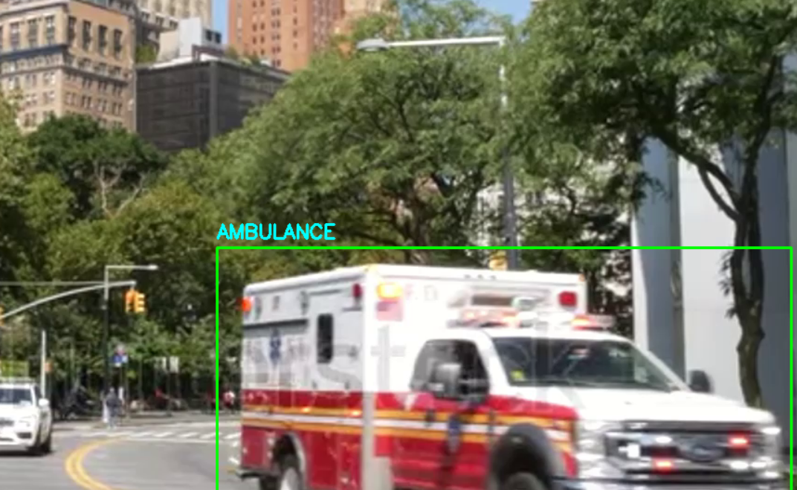
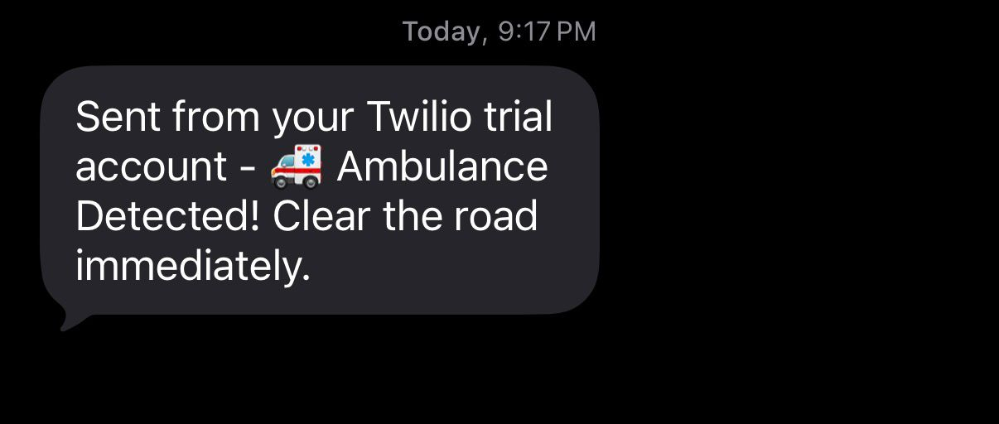
OUTPUT-SCREENSHOTS

Slide 14
REFERENCES
Joseph Redmon et al., “YOLO: You Only Look Once: Unified, Real-Time Object Detection,” Proceedings of the IEEE Conference on Computer Vision and Pattern Recognition (CVPR), 2016.
Ultralytics, “YOLOv8 Documentation,” Available at: https://docs.ultralytics.com/
OpenCV Documentation, “Open Source Computer Vision Library,” Available at: https://opencv.org/
Twilio Documentation, “Twilio SMS API,” Available at: https://www.twilio.com/docs/sms
Roboflow, “Computer Vision Dataset Management,” Available at: https://roboflow.com/
PyTorch Documentation, “Deep Learning Framework,” Available at: https://pytorch.org/

